Slide 1
Sports Betting in Canada
April, 2017
Harley Redlick, H. Redlick Consulting
Osgoode Certificate in Gaming Law

Slide 2
Agenda
Sports Betting 101
Canada Overview
Canadian Offering v. Global Competitors & Regional Comparisons – There are NO Monopolies
Case Study—OLG v. Norsk Tipping
Catch Me if You Can—How You Can Beat ProLine.

Slide 3
Sports Betting 101

Slide 4
Sports Betting 101
Types of bets:
Single game: point spread (50-50), over/under score (50-50), money line (odds/favorite)
Parlay: betting multiple events where they ALL need to win but payoff multiplies. Lottery
Exotics: season long, proposition bets
In Game wagering: bet on the game while it is in progress with dynamic updated odds
How do Sportsbooks make money: a markup fee on losing bets, known as VIG or juice. You generally lay 1.1x to win x on a flat bet (against the spread or over/under)
Types of Sportsbooks: Las Vegas (B&M), online (legal in most of Europe), local bookies (often giving credit)
Operator jargon:
Handle: Total amount wagered
Gross Gaming Yield (GGY): Revenue after winnings are paid out
Sportsbooks have the same general goal: balance the betting and collect a (usually) 10% fee from the losing bets (you lose approximately half the time so average take is approximately 5%, the GGY). Books catering to more astute gamblers (sharps) deal in big bets, and aim for ~3%. Books catering to casual players aim for 7% (get margins above 5 through parlays & exotics with extra VIG)
How do you balance action and limit risk: dynamic odds that change with betting action (info based, like stock market). Start with low limits to reduce exposure, increase it once betting market becomes deeper (more liquid and defined).

Slide 5
Canada Overview

Slide 6
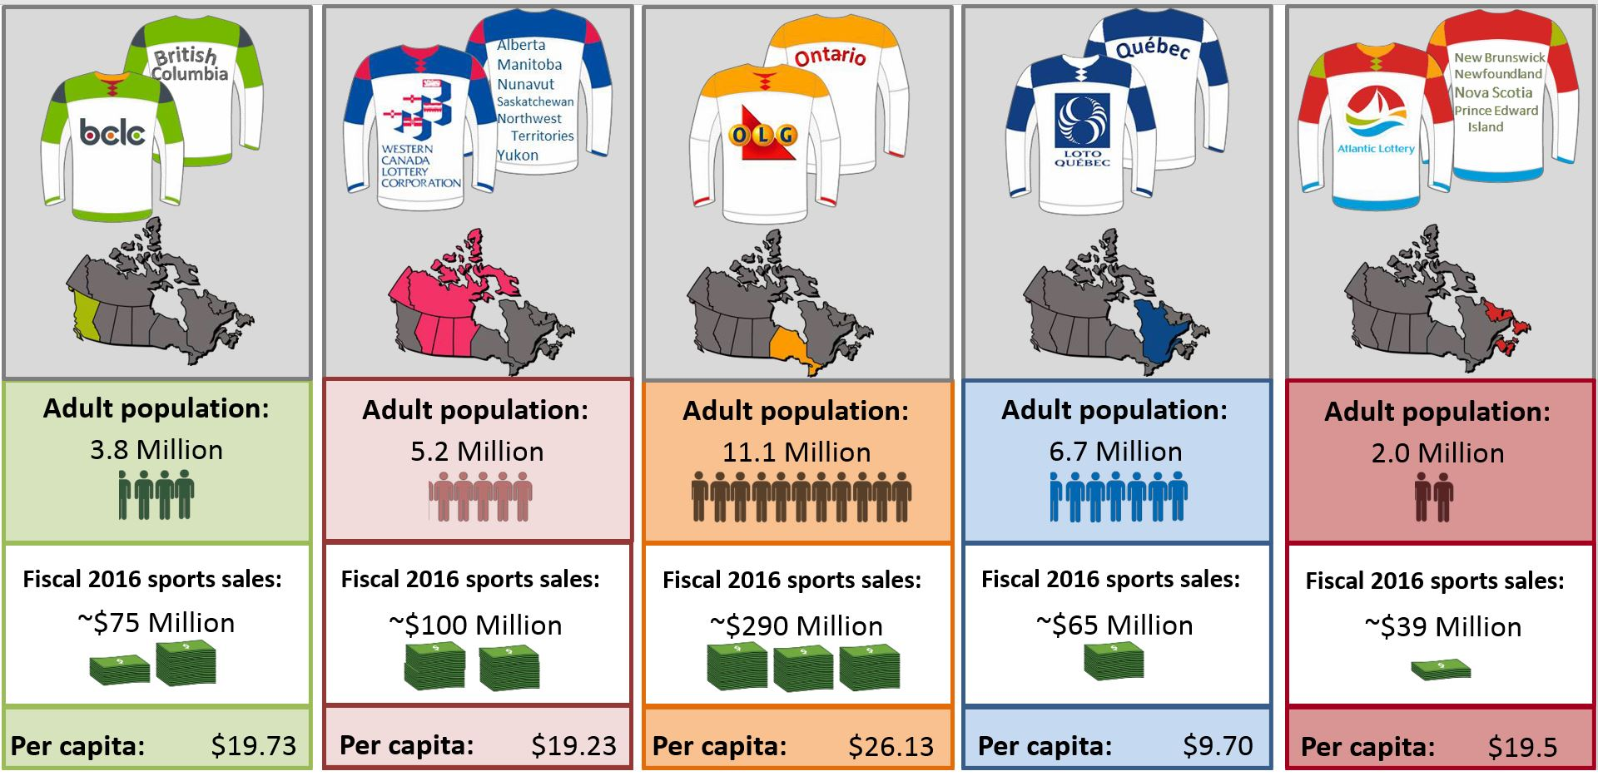
Sales By Lottery Corporation
Source: EL Sports Congress June 2016

Slide 7
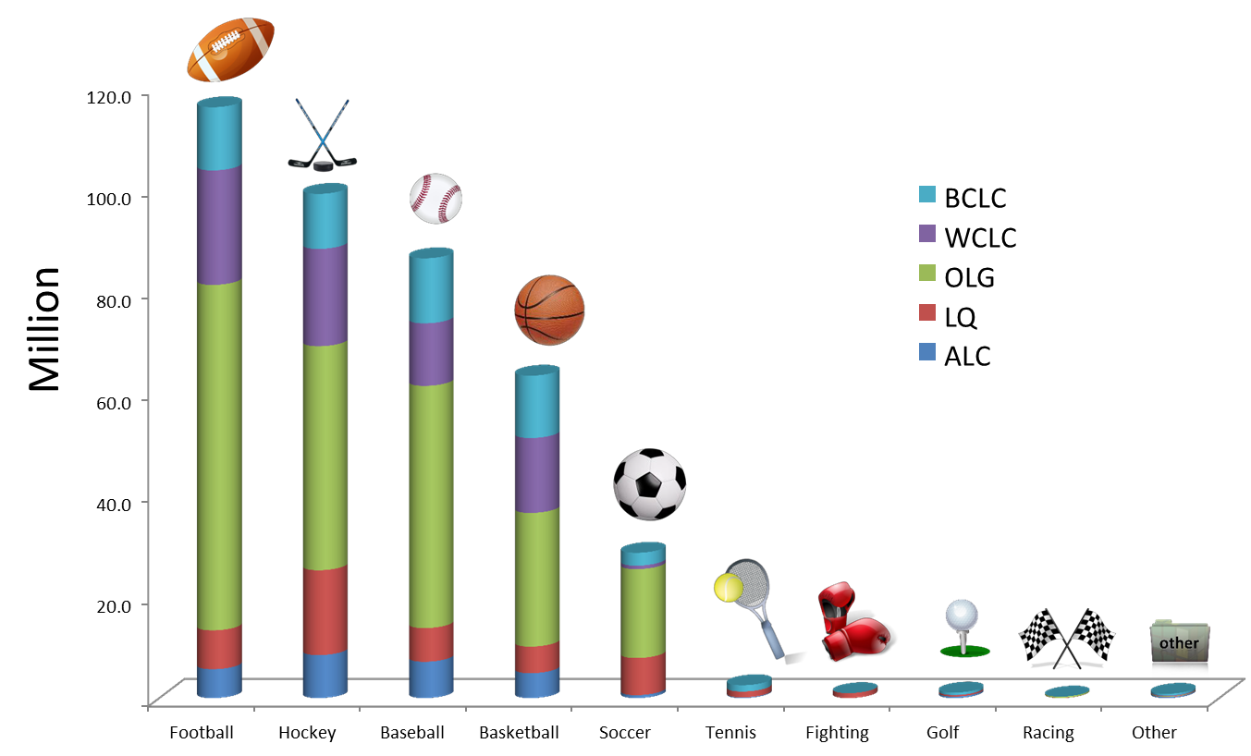
Sales by Sport by Lottery Corporation
Chart in Euros (multiply by 1.35). Approximately $560mil (of the $570mil) of Canadian sports lottery sales are in the 5 big team sports
Football leads the way with over $165mil in sales ($95mil in Ont – huge), followed by hockey at $140mil+ (vs being an ‘other’ in the US). Baseball has $120mil+ of sales (lots of games), followed by basketball (lots of games, but no NBA on ProLine in Ontario at the time of the data, hence less ‘green’ – has college) at $90mil and lastly soccer at $40mil (multicultural appeal only in Vancouver, Toronto, and Montreal)
Source: EL Sports Congress June 2016

Slide 8
Canadian Offering vs. Global Competitors & Regional Comparisons – There are NO Monopolies

Slide 9
Sports Betting in Canada
2016: Lotteries produced $200m+ in profit on ~$570m in sales
36% profit margin. Las Vegas & online sports books dream of 7%
BUT, the $200m represents less then 2% of overall $15b legal gaming win amount in Canada with other lotto products and casino games representing 98%+. (Its only 8% of total lotto sales in Ontario where Pro Line sales PP are relatively high)
Why so low?
Large grey or black market presence (CGA estimate total of $10-40 B ). Even with a conservative $10 B total and 4% margin, that’s 2x government run sports betting profit. IF its $35 B and 6%, its $2.1 B or more then 10x as profitable.
No legal single sports betting
Mobile offerings aren’t prevalent and are weak (in terms of bonus, offerings, user experience) relative to grey market

Slide 10
Sports Betting In Canada (Cont’d)
The criminal code BANS single sports betting in Canada (policy reason was fear of match fixing)
By forcing parlays, VIG (or juice or casino commission) multiplies, putting players at a significant disadvantage
Lottery mandated types of returns, 30%+ margins hurts players (remember sports books strive for 7%)
Many lotteries offer static (constant) odds:
forces operators to pull games vs dynamic (changing odds)
forces lottery operators to release lines slower (they are vulnerable to sharps and cannot be changed if unknown info goes a certain way)
The TWO factors above combine to create limited offerings (to limit exposure) reducing customer game selection and satisfaction (gamblers only remember pulled games that cost them money)
Offerings at retailers:
Hard as either dynamic (odds changing, tough to know what odds you get) or static (frustrating because games get pulled and you have to refill ticket)
Challenging in urban centers as operators do not have English as a 1st language and struggle to explain the problem the old machines may be having and are the ones reading it to customers off a faded screen

Slide 11
Comparing Provincial Offerings to Leading International Sports book: Tuesday April 11, 2017
Area | # of Bets | Sports | Min Games | Dynamic | In Game | Avg House Take%/bet | Min Avg House Take (%)*
Bet 365 | 10k+ | base, bask, soc, hky, golf, tennis, e-sports, car race, rugby, fighting, horseracing, dogracing, cycling, darts, golf, snooker, other | 1 | y | y** | 5 | 5
ALC ProLine | 122 | base, bask, soc, hky, MMA, | 2 | y | n | 11 | 23.2
Quebec Miseojeu | 1k+ | base, hock, soc, bask, fighting, car race, esports, rugby, tennis | 2 | y | n | 8.5-13.5 | 23.2
OLG ProLine | 59 | base, bask, soc *** | 3 | n | n | 15 | 52.1
WCLC Sport Select | 70 | base, bask, soc, hky | 3 | n | n | 15 | 52.1
BC Play Now | 10k+ | base, bask, soc, hky, golf, tennis, e-sports | 2 | y | n | 5 | 10.2
BC Sports Action | 61 | base, bask, soc, hky | 2 | n | n | 20 | 44
* Multiplies avg house take % by minimum number of games you have to bet. Lotto parlays CRUSH YOU, some bet 6, this 3
** Bet 365 has large in-game menu, 50%+ of European sports book business, under 20% Canter/US (newer but growing)
*** Ontario's Proline was the ONLY place not offering hockey playoff odds for Wednesday's games by Tuesday

Slide 12
Different Regions, Different Ways, Directions & Results
 | Sales (m) | Profit (m) | Margin | Internet (% of sale) | Adult Population (m) | Sales/P | Profit/P | Profit previous yr. | Annual Profit Growth (%)*
Atlantic | 39 | 13.3 | 34% | 15 | 2 | $19.50 | $6.65 | 14.3 | -7.0%
Quebec | 65 | 24.6 | 38% | 12 | 6.7 | $9.70 | $3.67 | 22.4 | 9.8%
Ontario | 290 | 105.2 | 36% | NONE | 11.1 | $26.13 | $9.48 | 115.9 | -9.2%
Western | 100 | 43.2 | 43% | 6 | 5.2 | $19.23 | $8.31 | 47.2 | -8.5%
BC | 75 | 21 | 28% | 40 | 3.8 | $19.74 | $5.53 | 18.6 | 12.9%
* Absolute figure. Ontario's population also ROSE by 1.5%, so decline even worse PP
Source: EL Sports Congress June 2016

Slide 13
Provincial Strategies & Results
Both BC & Quebec are coming from a really low base, with average profit per adult at approx. HALF of Western Canada and Ontario
However, BC & Quebec are pushing online wagering and boosting their product offerings and seeing strong growth rates
Western Canada & Ontario have had success with their high margin lotto offering: static odds & 3 event parlay requirement
OLG still enjoys the largest profit per person, BUT without an internet offering and declining growth, a change is if it hopes to have future success
It does not help OLG’s ProLine that half its population is in Toronto and the real estate boom has made it too expensive to run a convenience store (with lottery terminal). 9,600 current terminal machines (9,700 a year ago). Yorkdale & First Canadian Place lost its kiosks to pop up stores, gentrification has turned old convenience stories into hip new coffee shops
NOTE: Lottery sales for OLG are strong & growing. Up 15% and over $3.7BIL (gross). These key high level figures are strong and mask the lost potential in their sports offering (OLG under the right guidance could still pivot and see $5-20mil profit windfalls annually)

Slide 14
Case Study—OLG v. Norsk Tipping

Slide 15
Norway’s Dynamic Lottery Product Wins Out
 | OLG ProLine | Norsk Tipping
since | 1990s | 1940s
online? | NO | since 2001
dynamic? | NO | YES
Single Sport? | NO | YES
Avg Bet Take* | 15% | 12%
Minimum Avg Bet Take | 52% | 12%
Game release ** | slow | fast
In Game Betting? | NO | YES
Offerings? | >100 | 1000+
sports offered | approx. 4 | 10+
sales | $290,000,000 | $550,000,000
population | 13,600,000 | 5,000,000
sales per capita | $21 | $110
gross profit | $105,200,000 | $88,000,000
profit per capita*** | $8 | $18
gross profit margin | 36% | 16%
previous year sales | $115,900,000 | $87,700,000
YoY Profit Change | -$10,700,000 | $300,000
YoY Profit Growth | -9.23% | 0.34%
* But Norsk allows single sport so losing 12% v 5% at sportsbook, while OLG requires 3 bets so avg loss is 52% (15%^3)
** Norsk offered odds on the Leafs playoff game Monday (match set Sunday). OLG didn't release until Wednesday.
*** All people not just adults, tough to get other comps.
By embracing technology, with dynamic offerings, a long history, in-game and single sports betting, Norway’s lottery product offering is strong, earning more than 2x as much per capita
With lower margins, Norway’s model is more sustainable
Net profit is likely 3x as high because Norway’s dynamic odds are easy to outsource or manage
OLG creates its own games and odds with a team in SSM: inefficient way to run a globally competitive product

Slide 16
What does OLG do well in sports? POOLS!!!
Industry experts maintain that governments are GREAT at running lotteries, just not casinos and other complex products
OLG runs a form of lottery for sports called Pools and for them it’s a risk free, low cost, big hit
Its offered almost daily, in all sports, but is BY FAR the biggest for the NFL
Pick every game’s winner straight up, pay $5, win all the games, you win the (sometimes big) prize pool
OLG makes over $6mil on this from just 17 NFL weeks alone, 5+% of their profit, with ZERO risk and REDUCED cost (no staff to set lines, monitor line movement, etc.)
This pool product is SIMPLE, CHEAP, FUN, and has a chance for a BIG payday: key success factors for lottery products
By contrast, general OLG sports betting, with filling out a form at a convenience store with games taken off the board, old terminal machines that can’t read selections, multiple choices (pt. spread v PL, + or not), at overall low winning margins for the players is NOT COMPETITIVE when you can bet online from home

Slide 17
Catch Me if You Can How you can beat OLG’s ProLine

Slide 18
How Can One Make Money?
Question: recall that OLG’s profit margin is ‘only’ 36% BUT the MINIMUM average house take is OVER 52% (and MUCH HIGHER for some 5 & 6 game parlays). How can its overall margins be ‘so low’?
Answer: by finding inefficiencies in the government offerings, a sharp player can stay one step ahead of the OLG
What inefficiencies?
Static Odds
Correlated Parlays
Poorly Designed Government Games

Slide 19
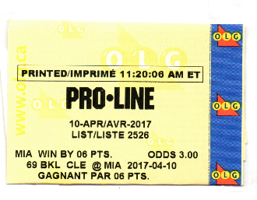
Making Money Through Static Odds
A dynamic sportsbook, whether live (in Las Vegas) or online, constantly changes the odds to reflect current information.
E.G. Miami ‘opened’ as a 2pt favorite (close game) vs Cleveland in NBA action. When it was announced midday that LeBron James and other Cleveland stars were resting, the line SHOTUP to 12 points
HOWEVER, ProLine has static odds that cannot move, so when MAJOR injuries occur, i.e., LeBron James is scratched, the other side of the bet (Miami) becomes a GREAT BET, and ProLine then has to pull the game to protect its liability
HOWEVER, before they get a chance to, attentive players bet
Miami at great odds
So, casual bettors lose out because they cannot bet the game as it isn’t offered, while Sharp bettors get a temporary great value play. Bettors on Miami got 3.00 (or 3-2 on their money), when the ‘correct’, non-LeBron price was well under 2.00. (extreme case)

Slide 20
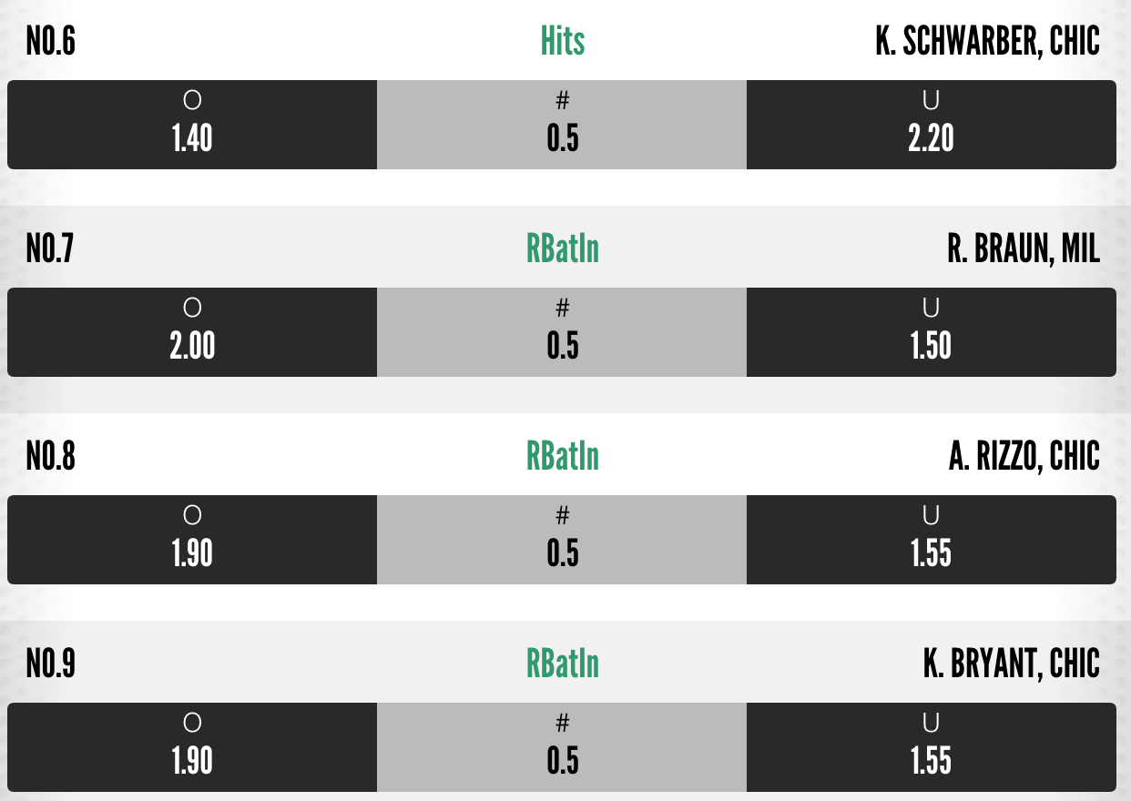
Making Money Through Correlated Parlays
When betting a parlay, the odds multiply so IF one event is strongly correlated, or partially dependent, on the outcome of another parlayed event, the player enjoys a potential advantage wager
ProLine offers this opportunity daily in its Props offerings
ProLine has to charge even MORE VIG on props, 17.5% (v 15% other PL) to the average player to compensate (38% avg payback, 62% OLG take for 3 team avg v 48%). IF you bet a random 6 teamer on Props, the OLG’s avg take is 84%, you get back 16 cents on the dollar wagered on Props. OLG is aiming to take approx. 40%
In this case, if Schwarber, the Cubs leadoff hitter, gets hits, there is a BETTER CHANCE, Rizzo or Bryant get an RBI. Highly correlated events.

Slide 21
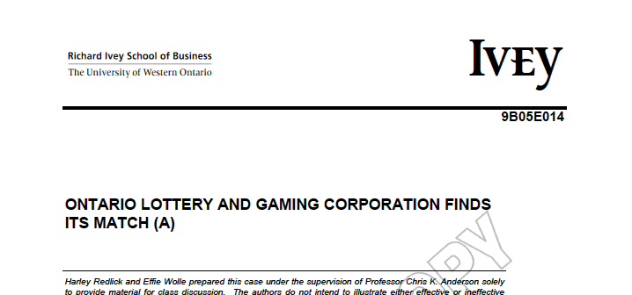
Making Money Through Poorly Designed Games
Given the constraints of parlay betting and the target of huge lottery style profit margins, OLG creatively designs their ‘own’ games
This is an attempt to keep customers re-engaged when they are losing 50%+ of their money per ProLine ticket
Sometimes the games they design are mathematically flawed
I ‘cracked’ the OLG’s Baseball
Hitting Game (BBH) in 2005, then
published this case for Ivey (see
www.sharpedgepicks.com
for detail)

Slide 22
Questions?

